Slide 1

Circuit-SAT is NPC III
Running algorithm A causes the memory of the computer to proceed through the set of all its configurations.
One of the bits in the last configuration is the output (yes/no).

Slide 2
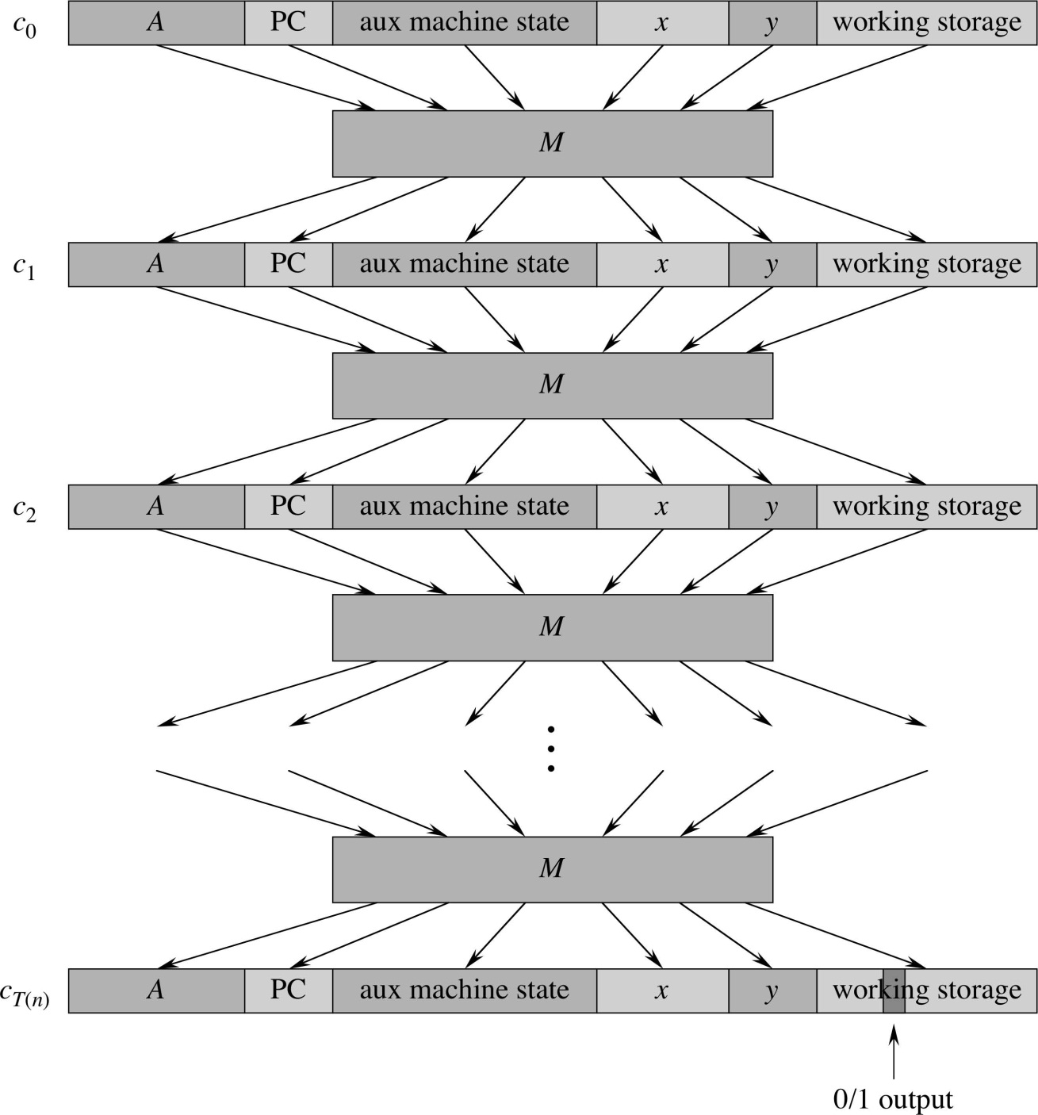
Circuit-SAT is NPC-IV

Slide 3
Circuit-SAT is NPC – V: Hard Theorem
Suppose A is a decision problem that is solvable in p(n) time by some program P, where n is the length of the input.
Then, for every fixed n, there is a circuit C_{n} of size O( p(n)² (log p(n))^{O(1)} ) such that for every input x = ( x₁, x₂, …, x_{n} ) of length n,
A(x) = C_{n}(x₁,x₂,…,x_{n}). That is, circuit C_{n} solves problem A on all inputs of length n.
Furthermore, there exists an efficient algorithm, running in time polynomial in p(n), that on input n and the description of P produces C_{n}.
people.eecs.Berkeley.edu/~daw/teaching/cs170-s03/Notes/lecture22.pdf

Slide 4
Circuit-SAT is NPC - VI
Basically, the algorithm A is producing T(n) successive configurations of memory.
So it runs in polynomial time.
There are polynomially many steps.
Each instruction executes in polynomial time.
And since it runs A, it verifies the same problem that A does.
So the reduction F is a polynomial time reduction.

Slide 5
Remember Reductions?
Remember the plan for reductions:
To show that a language L? is NPC, show that L? ∈ NP, and that some known NPC language L_{C} can be reduced to L? in polynomial time (L_{C} ≤_{P} L?).

Slide 6
Reduction: SAT → 3-CNF-SAT
Convert any Boolean formula consisting of AND, OR, and NOT to a formula consisting of the AND of triples of ORs, where each variable may be negated.
Example with 2-variable formulas:
Z = (!x ∨ y) ∧ (x ∨ y) becomes
Z = (!x ∨ y ∨ y) ∧ (x ∨ y ∨ y)
Example with 4-variable formula:
Z = (w ∨ x ∨ y ∨ z) becomes
Z = (w ∨ x ∨ p) ∧ (!p ∨ y ∨ z)
Dummy variable is added.

Slide 7
Reduction: SAT → 3-CNF-SAT
It can be proven that 3-CNF-SAT is NPC
Won’t do it.
You could hook together a bunch of 3-input OR gates as input to a humongous AND gate. This is a special case of CIRCUIT-SAT
3-CNF-SAT is useful for some reductions.

Slide 8
Clique
A clique in an undirected graph G = (V,E) is a subset of vertices V’ such that every vertex in V’ has an edge to every other vertex in V’.
It’s a fully connected subgraph.
Let CLIQUE be the decision problem
CLIQUE = { ⟨G,k⟩ : G is a graph containing a clique of size k}
Theorem: CLIQUE is NPC

Slide 9
Theorem: CLIQUE is NPC
Note: To show a problem L? (like CLIQUE) is NPC, we need to show that any instance of some NPC problem L_{C} (like 3-CNF-SAT) can be converted to some instance of problem L? (CLIQUE).
It is not necessary that any instance of Problem L? (CLIQUE) be mappable to some instance of Problem L_{C} (3-CNF-SAT)
Easy to see that CLIQUE is in NP
For all vertices in V’, verify that the vertex has an edge to every other vertex in V’.

Slide 10
Clique is NPC
We want to prove that 3-CNF-SAT ≤_{P} CLIQUE
Proof comment: To reduce problem A to problem B, you need to explain three things:
First, show how to convert an instance of problem A (3-CNF-SAT) into an instance of problem B (CLIQUE) in polynomial time.
Remember, A is known to be NPC and B is the problem we want to prove is NPC.
Show that a solution to A can be converted into a solution to B in polynomial time.
Show that a solution to B (that can be created by conversion from problem A) can be converted into a solution to A in polynomial time.
That way, if CLIQUE ∈ P, L_{C} ∈ P too, so CLIQUE is as hard as L_{C}, so CLIQUE ∈ NPC

Slide 11
Clique is NPC II
For each Boolean variable in an instance of 3-CNF-SAT, create a node of the graph. Connect all nodes to each other with edges, except for
Nodes from the same “triple” that are OR’ed together
Nodes that are mutually inconsistent (x and !x, for instance)
Example: Satisfy (x₁ ∨ !x₂ ∨ !x₃) ∧ (!x₁ ∨ x₂ ∨ x₃) ∧ (x₁ ∨ x₂ ∨ x₃)

Slide 12
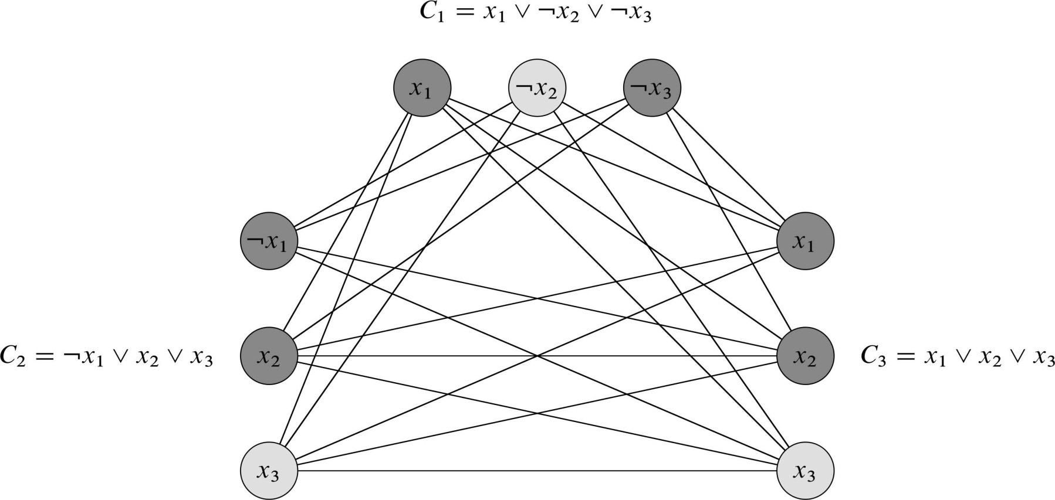
Clique is NPC III
Example: Satisfy (x₁ ∨ !x₂ ∨ !x₃) ∧ (!x₁ ∨ x₂ ∨ x₃) ∧ (x₁ ∨ x₂ ∨ x₃)
Basically, you connect each node n in a triple to every node in every other triple that is permitted to be true whenever n is true.

Slide 13
Clique is NPC IV
Suppose an instance of 3-CNF-SAT has k cliques of size 3 (triples). If 3-CNF-SAT has a satisfying assignment, then at least one element of each triple will be 1. (Note that this element might be !x, in which case x = 0.) The elements of the triples that are 1 will all be connected by edges, because they are in different triples and it is not possible that one element will be x and another !x. So the graph has a k-clique. (Here k = 3.)

Slide 14
Clique is NPC V
Suppose the graph has a k-clique. The elements of the k-clique are mutually consistent (they won’t contain an x and a !x). There is one element in each of the triples. So you can assign values to the elements in the k-clique so that each triple in 3SAT evaluates to 1, which is a satisfying assignment for 3SAT.

Slide 15
Other NP-Complete Problems
There are a lot more NP-Complete problems.
The rest of tonight we talk about some famous ones.
Warning: Many of these mappings are very clever.
Focus on understanding how they work.
If you think “I never could have thought of this!”, maybe you’re right, but most CS students couldn’t have done it either. That’s why the people who came up with them are famous.
But you should be able to understand them when explained.

Slide 16
TSP Tour
The following all refer to the same problem:
Hamiltonian Cycle (Cormen text)
Rudrata Cycle (some other texts)
TSP Tour
Note we’re just asking if some tour exists, not what the minimum distance tour is.
Normally the TSP Tour problem assumes a directed graph.
It’s very hard to reduce 3-CNF-SAT to TSP Tour.
I’m not going to show this
But it’s fairly easy to convert the TSP tour on a directed graph to one on an undirected graph.

Slide 17
Note on Hamiltonian Path/Cycle Problems
The Hamiltonian Path problem is a subset of the Hamiltonian cycle (TSP tour) problem.
You find a way in a graph to start at a given node and visit every other node without visiting any node twice.
It’s a TSP tour without the last step of going back to the beginning.
This Hamiltonian Path problem, too, is NP-Complete.

Slide 18
TSP Tour ∈ NP
It’s easy to verify in polynomial time if a path that starts and ends at a given node passes through each other node in the graph exactly once.

Slide 19
TSP Tour: Reduce Directed → Undirected
To map directed → undirected, we replace each node x in a TSP tour graph with a triple of 3 nodes, x^{in}, x^{mid}, x^{out}, connected to each other. If there’s an edge from x to y in the directed graph, there’s an edge between x^{out} to y^{in} in the undirected graph.

Slide 20
TSP Tour: Reduce Directed → Undirected

Slide 21
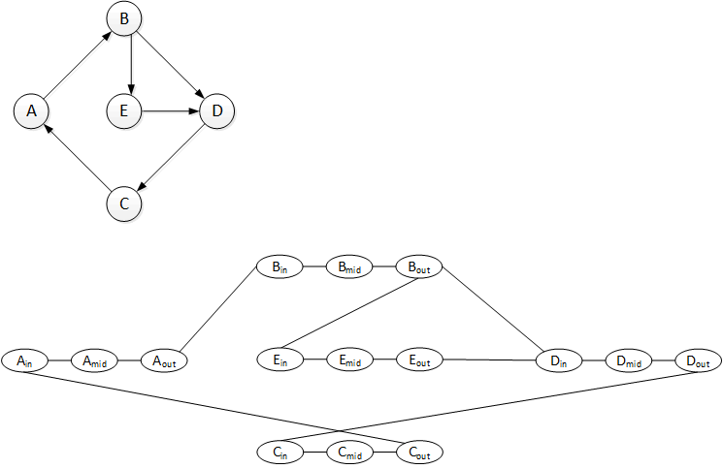
Directed Cycle → Undirected Cycle
If there’s a Ham Cycle in the directed graph, then there’s one in the undirected graph.

Slide 22
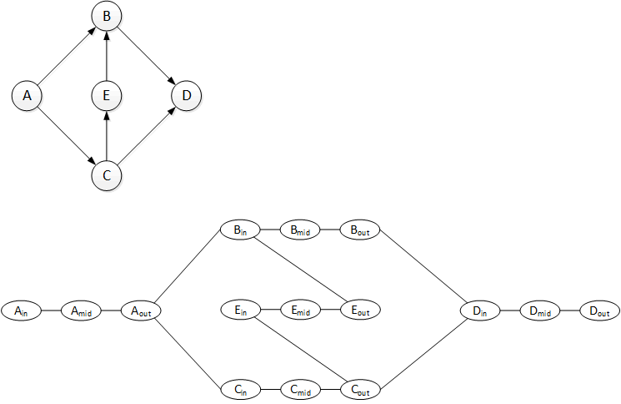
No Directed Cycle → No Undirected Cycle
If there’s no Ham Cycle in the directed graph, then there’s none in the undirected graph.

Slide 23
Vertex Cover
A vertex cover (VC) of size k of a graph is a subset of k nodes such that every edge is incident on at least one node in the cover.
Note that you’re covering all the edges with a set of nodes.

Slide 24
Vertex Cover
For example, imagine a set of straight streets, with security cameras at intersections. Assume that a security camera can see all the way to the next intersection, and can swivel 360º.
A VC for this set of streets would be a subset of the intersections such that if you had a camera at each intersection in the subset, you could focus at least one camera on every street.

Slide 25
Vertex Cover
The Vertex Cover problem is NP-Complete.
We reduce this from the CLIQUE problem.

